Slide 1

GAS LEAKAGE DETECTION
PRETI SHERINE P(210701195)
PRISCILLA RACHEL G(210701196)
SHANDIYA N S(210701240)
YUVAMALINI M(210701507)

Slide 2

Gas leakage imposes a significant threat to both safety of beings and the properties present in that particular area. This also affects the environment when harmful gasses are emitted in the air. Hence there is a constant need to monitor the gas value present in order to detect any leak that might take place
PROBLEM STATEMENT

Slide 3

PROBLEM STATEMENT
Gas leakage imposes a significant threat to both safety of beings and the properties present in that particular area. This also affects the environment when harmful gasses are emitted in the air. Hence there is a constant need to monitor the gas value present in order to detect any leak that might take place

Slide 4
Gas Leakage impacts a significant threat to both life and property. Hence Gas Leakage Detection System are important for safeguarding lives and properties against the danger posed by leaking gas such as methane, propane etc. Early detection is crucial in preventing accidents ,explosion and health hazard associated with gas leaks
INTRODUCTION

Slide 5
INTRODUCTION
Gas Leakage impacts a significant threat to both life and property. Hence Gas Leakage Detection System are important for safeguarding lives and properties against the danger posed by leaking gas such as methane, propane etc. Early detection is crucial in preventing accidents ,explosion and health hazard associated with gas leaks

Slide 6
PURPOSE
PROTECT LIFE AND PROPERTY
MINIMIZE ENVIRONMENTAL IMPACT
ASSET PRESERVATION
PUBLIC CONFIDENCE

Slide 7
PURPOSE
PROTECT LIFE AND PROPERTY
MINIMIZE ENVIRONMENTAL IMPACT
ASSET PRESERVATION
PUBLIC CONFIDENCE

Slide 8

COMPONENTS

Slide 9


COMPONENTS USED
SOFT WARE
HARD WARE
1)MQ2 SENSOR
1)ARDUINO IDE
2)ARDUINO UNO
2)C++
3)BREADBOARD
4)LCD DISPLAY
5)LED
6)BUZZER
7)SIM 800L

Slide 10
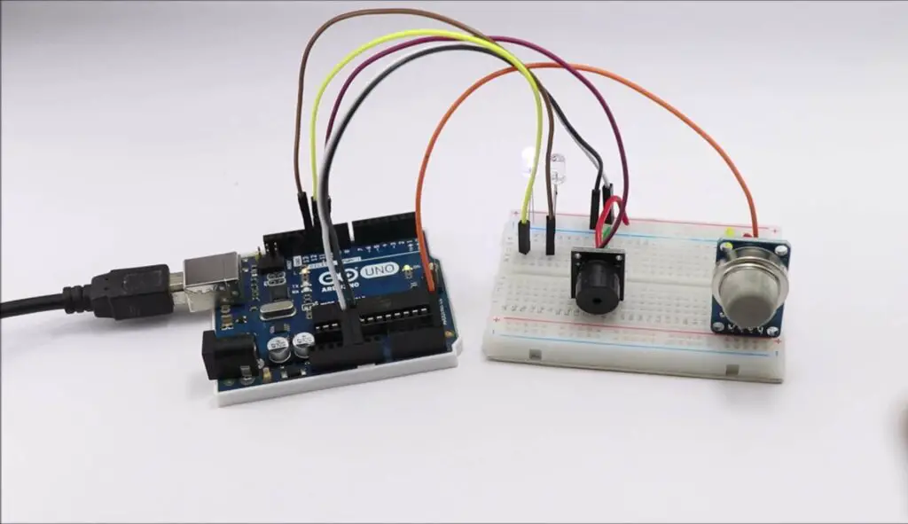
EXISTING SYSTEM

Slide 11
MQ2 GAS SENSOR
ARDUINO UNO
BUZZER
Micro Controller
Gas detection
Sound output
Beginner friendly
High sensitivity
Low power consumption
USB Connection
Simple Integration
Cost effective
Digital and Analog pins
Affordable
Versatile application
ARDUINO UNO

Slide 12
MQ2 GAS SENSOR
ARDUINO UNO
BUZZER
MQ2 GAS SENSOR
Gas detection
Sound output
Micro Controller
Beginner friendly
High sensitivity
Low power consumption
USB Connection
Simple Integration
Cost effective
Digital and Analog pins
Affordable
Versatile application

Slide 13
MQ2 GAS SENSOR
ARDUINO UNO
BUZZER
Micro Controller
Gas detection
Sound output
Beginner friendly
High sensitivity
Low power consumption
USB Connection
Simple Integration
BUZZER
Cost effective
Digital and Analog pins
Affordable
Versatile application

Slide 14
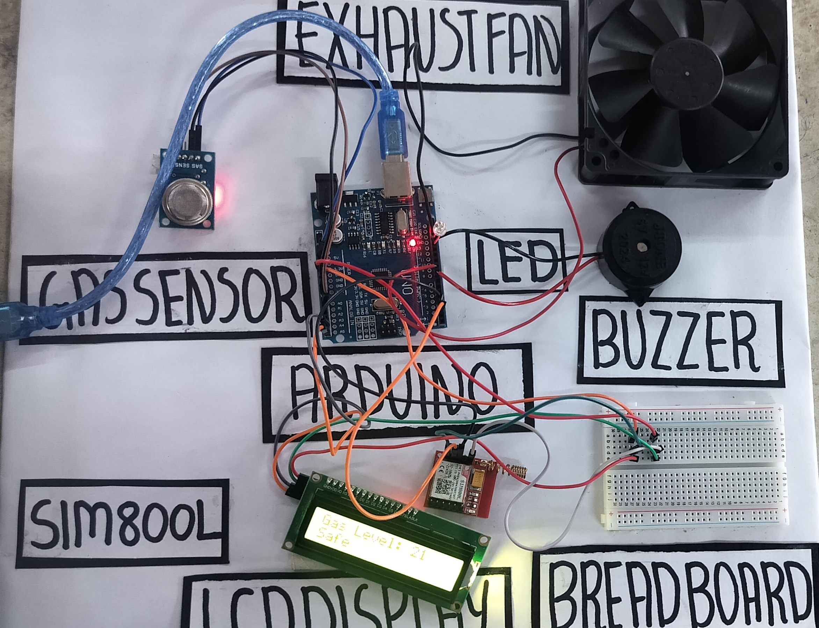
PROPOSED SYSTEM

Slide 15

EXHAUST FAN
LED
LCD DISPLAY
SIM 800L
AIR VENTILATION
LONG LIFESPAN
DISPLAYS CURRENT STATUS
COMMUNICATION
COMMON LOCATION
COMPACT SIZE
GSM AND GPRS
THIN AND LIGHT WEIGHT
ENERGY EFFICIENT
SAFE
EMBEDDED SIM FUNCTINALITY
MAINTANENCE
ENVIRONMENTAL FRIENDLY
FAST RESPONCE

Slide 16
EXHAUST FAN
LED
LCD DISPLAY
SIM 800L
AIR VENTILATION
LONG LIFESPAN
DISPLAYS CURRENT STATUS
COMMUNICATION
COMMON LOCATION
COMPACT SIZE
GSM AND GPRS
THIN AND LIGHT WEIGHT
ENERGY EFFICIENT
SAFE
EMBEDDED SIM FUNCTINALITY
MAINTANENCE
ENVIRONMENTAL FRIENDLY
FAST RESPONCE

Slide 17
EXHAUST FAN
LED
LCD DISPLAY
SIM 800L
AIR VENTILATION
LONG LIFESPAN
DISPLAYS CURRENT STATUS
COMMUNICATION
COMMON LOCATION
COMPACT SIZE
GSM AND GPRS
THIN AND LIGHT WEIGHT
ENERGY EFFICIENT
SAFE
EMBEDDED SIM FUNCTINALITY
MAINTANENCE
ENVIRONMENTAL FRIENDLY
FAST RESPONCE

Slide 18
EXHAUST FAN
LED
LCD DISPLAY
SIM 800L
AIR VENTILATION
LONG LIFESPAN
DISPLAYS CURRENT STATUS
COMMUNICATION
COMMON LOCATION
COMPACT SIZE
GSM AND GPRS
THIN AND LIGHT WEIGHT
ENERGY EFFICIENT
SAFE
EMBEDDED SIM FUNCTINALITY
MAINTANENCE
ENVIRONMENTAL FRIENDLY
FAST RESPONCE

Slide 19
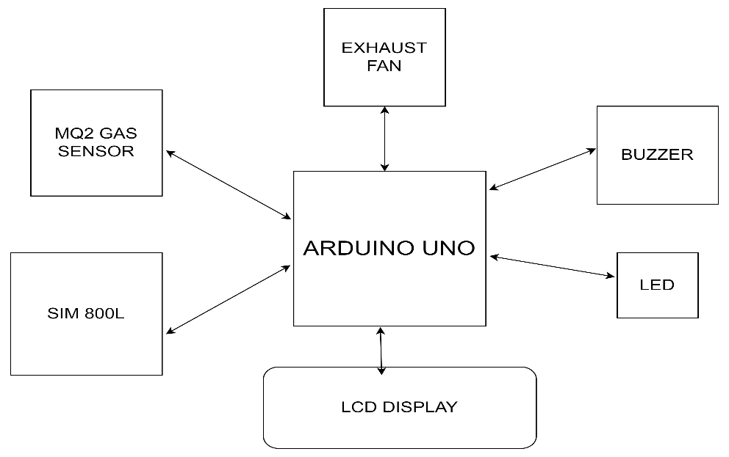
SYSTEM ARCHITECTURE

Slide 20


BENIFITS
ENERGY SAVING
CONVENIENCE
COST REDUCTION
SAFETY ENHANCEMENT
CUSTOMIZATION

Slide 21


MODULES USED
GAS SENSING MODULE
ALERTING MODULE
CONTROL MODULE
COMMUNICATION MODULE
VENTILATION MODULE

Slide 22
2)ALERTING MODULES
4)COMMUNICATION MODULE
5
3)CONTROL MODULE
5)VENTILATION MODULE
1)GAS SENSING MODULE
MQ2 SENSOR-DETECTS THE PRESENCE OF GAS IN ENVIRONMENT
4
BUZZER-PROVIDES AUDIBLE ALERT
SIM 800L- FACILATES COMMUNICATION WITH EXTERNAL DEVICES BY GIVING CALL
EXHAUST FAN-HELPS IN VENTILATION AND EXPEL GASES IN CASE OF GAS LEAKAGE
BREADBOARD-
CONNECTS VARIOUS COMPONENTS OF THE SYSTEM
3
LCD DISPLAY-DISPLAYS THE ALERT MESSAGE
ARDUINO UNO-INTERFACES WITH THE GAS SENSOR AND PROCESSES THE DATA
2
ARDUINO UNO-
OPERATES THE EXHAUST FAN,LED
SIM 800L-ALERTS USING CALL
1

Slide 23
2)ALERTING MODULES
4)COMMUNICATION MODULE
5
3)CONTROL MODULE
5)VENTILATION MODULE
1)GAS SENSING MODULE
4
MQ2 SENSOR-DETECTS THE PRESENCE OF GAS IN ENVIRONMENT
BUZZER-PROVIDES AUDIBLE ALERT
SIM 800L- FACILATES COMMUNICATION WITH EXTERNAL DEVICES BY GIVING CALL
EXHAUST FAN-HELPS IN VENTILATION AND EXPEL GASES IN CASE OF GAS LEAKAGE
BREADBOARD-
CONNECTS VARIOUS COMPONENTS OF THE SYSTEM
3
LCD DISPLAY-DISPLAYS THE ALERT MESSAGE
ARDUINO UNO-INTERFACES WITH THE GAS SENSOR AND PROCESSES THE DATA
2
ARDUINO UNO-
OPERATES THE EXHAUST FAN,LED
SIM 800L-ALERTS USING CALL
1

Slide 24
4)COMMUNICATION MODULE
5
2)ALERTING MODULES
3)CONTROL MODULE
5)VENTILATION MODULE
1)GAS SENSING MODULE
4
MQ2 SENSOR-DETECTS THE PRESENCE OF GAS IN ENVIRONMENT
SIM 800L- FACILATES COMMUNICATION WITH EXTERNAL DEVICES BY GIVING CALL
BUZZER-PROVIDES AUDIBLE ALERT
EXHAUST FAN-HELPS IN VENTILATION AND EXPEL GASES IN CASE OF GAS LEAKAGE
BREADBOARD-
CONNECTS VARIOUS COMPONENTS OF THE SYSTEM
3
LCD DISPLAY-DISPLAYS THE ALERT MESSAGE
ARDUINO UNO-INTERFACES WITH THE GAS SENSOR AND PROCESSES THE DATA
2
ARDUINO UNO-
OPERATES THE EXHAUST FAN,LED
SIM 800L-ALERTS USING CALL
1

Slide 25
4)COMMUNICATION MODULE
5
2)ALERTING MODULES
5)VENTILATION MODULE
3)CONTROL MODULE
1)GAS SENSING MODULE
4
MQ2 SENSOR-DETECTS THE PRESENCE OF GAS IN ENVIRONMENT
SIM 800L- FACILATES COMMUNICATION WITH EXTERNAL DEVICES BY GIVING CALL
BUZZER-PROVIDES AUDIBLE ALERT
EXHAUST FAN-HELPS IN VENTILATION AND EXPEL GASES IN CASE OF GAS LEAKAGE
BREADBOARD-
CONNECTS VARIOUS COMPONENTS OF THE SYSTEM
3
LCD DISPLAY-DISPLAYS THE ALERT MESSAGE
ARDUINO UNO-INTERFACES WITH THE GAS SENSOR AND PROCESSES THE DATA
2
ARDUINO UNO-
OPERATES THE EXHAUST FAN,LED
SIM 800L-ALERTS USING CALL
1

Slide 26
5)VENTILATION MODULE
5
2)ALERTING MODULES
4)COMMUNICATION MODULE
3)CONTROL MODULE
1)GAS SENSING MODULE
MQ2 SENSOR-DETECTS THE PRESENCE OF GAS IN ENVIRONMENT
4
BUZZER-PROVIDES AUDIBLE ALERT
EXHAUST FAN-HELPS IN VENTILATION AND EXPEL GASES IN CASE OF GAS LEAKAGE
SIM 800L- FACILATES COMMUNICATION WITH EXTERNAL DEVICES BY GIVING CALL
BREADBOARD-
CONNECTS VARIOUS COMPONENTS OF THE SYSTEM
3
LCD DISPLAY-DISPLAYS THE ALERT MESSAGE
ARDUINO UNO-INTERFACES WITH THE GAS SENSOR AND PROCESSES THE DATA
2
ARDUINO UNO-
OPERATES THE EXHAUST FAN,LED
SIM 800L-ALERTS USING CALL
1

Slide 27
2)ALERTING MODULES
4)COMMUNICATION MODULE
3)CONTROL MODULE
1)GAS SENSING MODULE
5)VENTILATION MODULE
5
MQ2 SENSOR-DETECTS THE PRESENCE OF GAS IN ENVIRONMENT
4
BUZZER-PROVIDES AUDIBLE ALERT
SIM 800L- FACILATES COMMUNICATION WITH EXTERNAL DEVICES BY GIVING CALL
BREADBOARD-
CONNECTS VARIOUS COMPONENTS OF THE SYSTEM
EXHAUST FAN-HELPS IN VENTILATION AND EXPEL GASES IN CASE OF GAS LEAKAGE
3
LCD DISPLAY-DISPLAYS THE ALERT MESSAGE
ARDUINO UNO-INTERFACES WITH THE GAS SENSOR AND PROCESSES THE DATA
2
ARDUINO UNO-
OPERATES THE EXHAUST FAN,LED
SIM 800L-ALERTS USING CALL
1

Slide 28
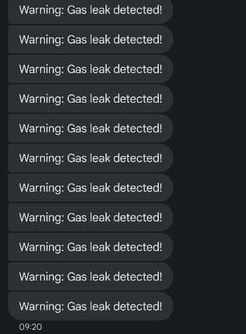
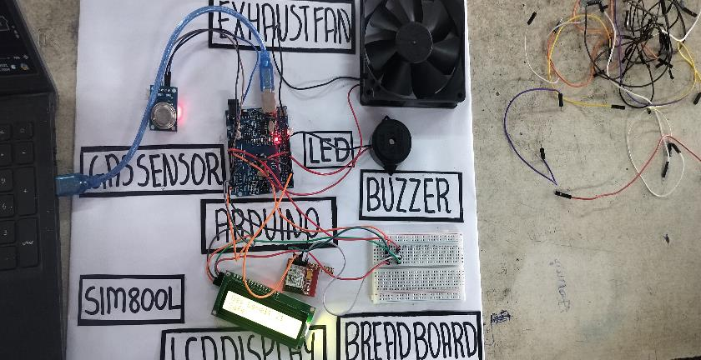
RESULT

Slide 29
CONCLUSION
KEY FEATURES
REAL-TIME MONITORING
IMMEDIATE ALERTS
AUTOMATED RESPONSE
REMOTE NOTIFICATION

Slide 30
CONCLUSION
KEY FEATURES
REAL-TIME MONITORING
IMMEDIATE ALERTS
AUTOMATED RESPONSE
REMOTE NOTIFICATION

Slide 31
REFERENCES
[1] SMITH J (2019) “IOT BASED LEAK DETECTION SYSTEM”
[2] JOHNSON J (2020) “SENSOR BASED TECHNOLOGY FOR GAS DETECTION SYSTEM
[3] WANG H (2018) “ANOMALY DETECTION ALGORITHM FOR GAS LEAKAGE”
[4] GUPTA R (2020) “A MACHINE LEARNING BASED STUDY FOR GAS LEAKAGE”
[5] LI X (2018) “WEB-BASED INTERFACE FOR REMOTE MONITORING IOT SYSTEM”

Slide 32
THANK YOU!!!!

